Slide 1
High Performance Content Based Matching Using Multiple GPGPU and MPI-GPGPU Approach
Abhijeet Kulkarni (2012BCS031)
Suyog Jain (2012BCS026)
Nitesh Sakle (2012BCS013)

Slide 2
Introduction
In the near future, the majority of human information will be in the Web.
The searching, querying and retrieving information approach, while very efficient for static information, does not integrate well with the dynamic aspect of the Web.
To address this issue, notification systems emerged, being able to capture the dynamic aspect of the Web by notifying users of interesting events.
The Event Notification system is able to cope with high rate of events, large number of user demands (post subscription, remove subscription) and efficiently notify users with very short delay.

Slide 3
Introduction
Publish-subscribe (pub-sub) is an important paradigm for asynchronous communication between entities in a distributed network.
In the pub-sub model, subscribers typically receive only a subset of the total messages published.
The process of selecting messages for reception and processing is called filtering.

Slide 4
Content Based Pub-Sub System
Subscribers have the added flexibility of choosing filtering criteria along multiple dimensions, using thresholds and conditions on the contents of the message.
They present a unique challenge for efficient matching of events to subscriptions.
In a large-scale pub-sub system, there are millions of subscriptions maintained by brokers and millions of events to be matched every second.

Slide 5
Events & Predicate
An event notification, or simply event, is represented as a set of attributes, i.e., (name, value) pairs.
As an example, e1 =[(area,”area1“); (temp, 25); (wind, 15)] is an event that an environmental monitoring component could publish to notify the rest of the system about the current temperature and wind speed in the area it monitors.
The interests of components are modelled through predicates, each being a disjunction of filters, which, in turn, are conjunctions of elementary constraints on the values of single attributes.
As an example, f1 = (area = “area1" ^ temp >30) is a filter composed of two constraints, while p1 =[(area = “area1" ^ temp > 30) V (area = “area2" ^wind >20)] is a predicate composed of two lters.

Slide 6
Cuda Content-Based Matcher
The CUDA Content-based Matcher (CCM) algorithm is composed of two phases: a constraint selection phase and a constraint evaluation and counting phase.
When an event enters the engine, the first phase is used to select, for each attribute a, of the event, all the constraints having the same name as a.
These constraints are evaluated in the second phase, using the value of a.
We keep a counter of satisfied constraints for each filter stored by the system: when a constraint c is satisfied, we increase the counter associated to the filter c belongs to.
If a filter matches an event so does the predicate it belongs to.
Accordingly, the event can be forwarded to the interface exposing it.

Slide 7
Content Matching using Multiple GPGPU’s
Two parallelization techniques using multiple GPGPUs for event processing:
Multiple Events Independent Processing (MCCM for parallel events): to increase throughput
Single Event Collaborative Processing (MCCM for single event):to reduce matching time of a single event.

Slide 8
Multiple Events Independent Processing (MCCM Parallel Events)
The aim of this parallelization technique is to increase system throughput (i.e., number of events processed per second).
A distinct event is given to every GPGPU for processing.
Data pertaining to Constraints and Interfaces tables on host are transferred to the memory of every GPGPU asynchronously using default stream of GPGPU.
For each event, GPGPU executes matching algorithm.

Slide 9
Multiple Events Independent Processing (MCCM Parallel Events)
After processing, results are copied to interface array maintained on CPU for every GPGPU asynchronously.
Once the event is processed, it fetches the next available events from input stream.
Minimal synchronization is needed in this approach.

Slide 10
Single Event Collaborative Processing (MCCM Single Event)
The aim of this parallelization technique is to improve matching time for a single event.
In this approach we divide the interfaces among number of GPGPU's.
The Filter and Constraints table will consists of filters corresponding to Interfaces assigned to particular GPGPU.
These Filter and Constraints table are then respectively copied to GPGPU asynchronously.
We used offset to collect results from multiple GPUs asynchronously in single interface array.
Uneven distribution of filters in interfaces leads to minor degradation in performance due to difference in event matching time of individual device.

Slide 11
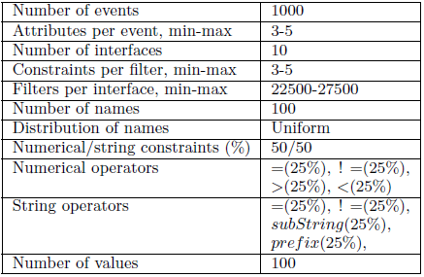
Parameters in Default Scenario

Slide 12
Performance of MultiGPU Algorithm
Number Of Interfaces : Change in performance with increasing number of interfaces.
It is observed that beyond certain limit of interfaces CCM, doesn’t provide results.
The reason may be memory limit of single GPU.
MCCM (Single Event) produces result for large values of interfaces.
Processing time is low for algorithm MCCM (Single event) as it divides the interfaces among available GPGPUs.

Slide 13
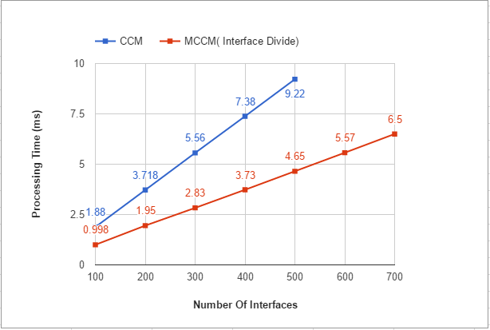

Slide 14
Performance of MultiGPU Algorithm
Number of Filters Per Interface : Change in performance with the number of filters per interface.
Increasing such number also increases the overall number of constraints, and thus the complexity of matching.
Accordingly, all the algorithms show growing, processing times.
MCCM (single event) exhibits good for performance with increasing number of filters per interfaces.

Slide 15
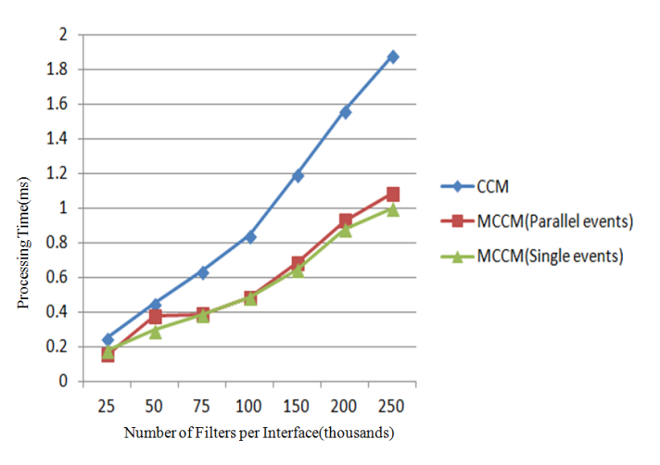

Slide 16
The MPI-GPU Approach
Message Passing Interface (MPI) is a standardized and portable message-passing system designed by a group of researchers from academia and industry to function on a wide variety of parallel computers
This approach takes benefits of the CCM algorithm and combines it with high level parallelism using MPI.
A Beowulf cluster is a computer cluster of what are normally identical, commodity-grade computers networked into a small local area network with libraries and programs installed which allow processing to be shared among them.

Slide 17
MPI-GPU Algorithm
Get number of GPU’s available on each system connected in cluster.
Assign each device to process on system.
If master process
Get all subscriptions.
Transfer them to all process
Else
Receive subscriptions from master process.
Transfer subscriptions to GPU’s assigned to the process.

Slide 18
5. If master process
while all events not processed
Receive matched interfaces from ‘x’ process
Send incoming events to ‘x’ process
Else
while(true)
Receive event from master process
If number of attributes in event equals zero then break;
Process Event
Send matched interfaces to master process.

Slide 19
MPI-GPU System
We do not need any special software for cluster. Bewoulf Cluster is password-less ssh.
MPI-GPU approach takes advantage of multiple nodes available in the network therefore utilizing all available GPU. The system needs to be scalable.
Load-Balancing occurs in the MPI-GPU approach.
Communication overhead.

Slide 20
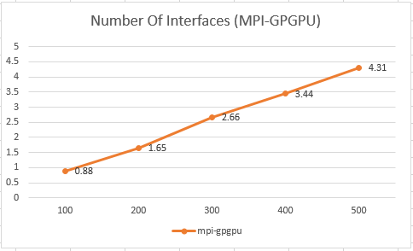
Analysis Of MPI-GPGPU Approach

Slide 21
Comparison Of All Approaches
CCM | MCCM(Parallel Events) | MCCM(Single Event) | MPI-GPGPU
0.25245ms | 0.1505ms (1.6x) | 0.1798ms (1.4x) | 0.1254ms (2x)

Slide 22
Thank You..!!

